Slide 1
The US Philanthropy and Its Influence on China’s Higher Education
Chaoyi Chen
Higher Education: Policy and Development in Asia
March 30, 2017
Notes:
I am Chaoyi. Today, my topic is about the US philanthropy and its influence on China’s higher education.

Slide 2
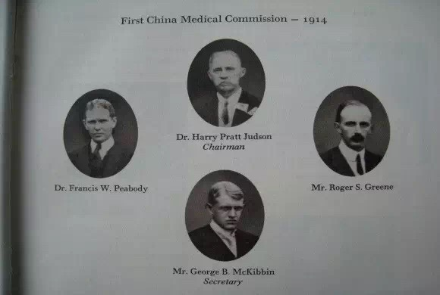
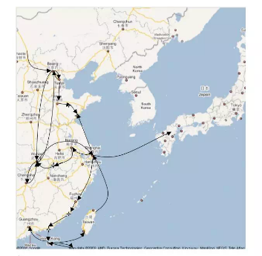
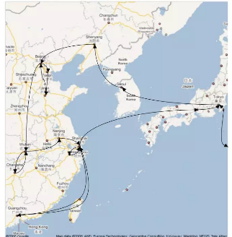
The Rockefeller Foundation (1914 - 1915) – Medical Education
Notes:
The story started from hundred years ago.
The Rockefeller Foundation sent two survey groups in 1914 and 1915 to China to gather information about how a medical education program could operate.
The China Medical Board (CMB), with a $10 million endowment, was created by the Rockefeller to modernize medical education and to improve the practice of medicine in China.

Slide 3
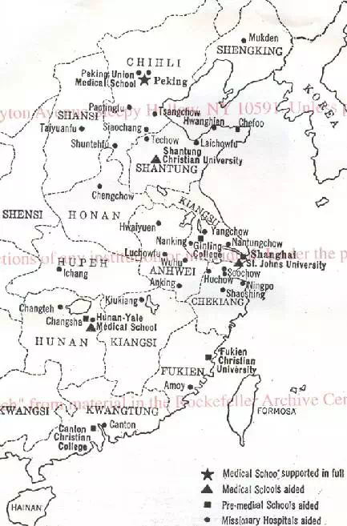
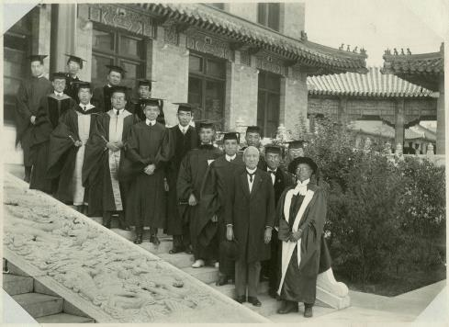
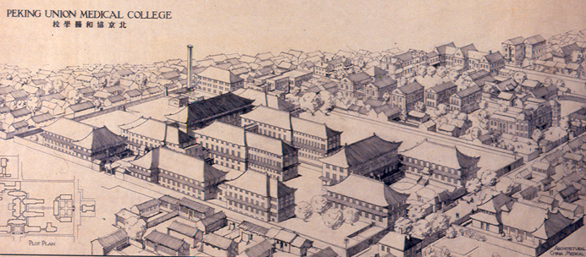
The Rockefeller Foundation (1915-1951) – Medical Education
Notes:
In the late 1915, CMB purchased the Union Medical College and changed the name to the Peking Union Medical College (PUMC) in 1921.
PUMC was small but its standards remained high. More than half of its graduates became leaders in medical administration, teaching and research.
This map shows other hospitals and medical schools CMB supported.

Slide 4
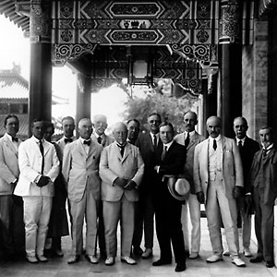
The Rockefeller Foundation (1951) – Medical Education
In 1951, the Chinese government nationalized PUMC and broke ties with the Foundation and CMB.
Between 1915 and 1951, the Foundation spent over $50 million on medical initiatives in China.
It made extraordinary and enduring contributions and left profound influence to China’s health system.
Notes:
However, because of the war and political shift, in 1951, the Chinese government nationalized PUMC and broke ties with the Foundation and CMB.
Between 1915 and 1951, the Foundation spent over $50 million on medical initiatives in China.
There is no doubt that it made extraordinary and enduring contributions and left profound influence to China’s health system.

Slide 5
The Ford Foundation – International Relations, Economics, and Law
Cold War: granted millions of dollars on the study of China
1979: started working in China and supported the direct exchanges
1988: opened an office in Beijing (still in operation)
It has given over $360 million in grants in China.
Support Chinese academic institutions to strengthen the disciplines of international relations, economics, and law.
Notes:
There is another foundation granting millions of dollars on the study of China even during the confrontation period, the Ford Foundation.
Right after the normalization of China-U.S. relations, the Foundation started working in China and supported the direct exchanges.
It opened an office in Beijing in 1988, which is still in operation.
It has given over $360 million in grants in China.
A large portion of them went to support Chinese academic institutions to strengthen the disciplines of international relations, economics, and law.

Slide 6
Two Channels to Support China’s Higher Education
Direct Grant Programs by
US Foundations and Companies
Individuals
Apply for grants directly
Have branches or offices in China.
MNCs: Pfizer, Dow, Unilever, Johnson and Johnson
Big Private Foundations: the Rockefeller and the Ford
Other China related US foundations: the US-China Strong Foundation, the Asia Society, and the China Institute
Foundations
China’s Higher Education
Corporates
Notes:
Now, there are more and more US individuals and foundations support China’s higher education. From my observation, there are two channels.
One is direct grant programs running by US foundations or companies. Students and professors can apply for grants from them directly.
Normally they have branches or offices in China. MNCs are like Pfizer, Dow, Unilever, Johnson and Johnson. Big foundations are like the Rockefeller and the Ford. Other China related US foundations also have such programs, for examples, the US-China Strong Foundation, the Asia Society, the China Institute, etc.

Slide 7
Two Channels to Support China’s Higher Education
Donations through University
Related Foundations
Individuals
Foundations
There are 459 university-related foundations in China.
Donors should sign donation agreements with the university foundation not the university.
1) Stephen Schwarzman’s $300 million
2) the Starr Foundation’s $5 million
Trend:
China’s Higher Education
Corporates
Notes:
Another is donations through university related foundations.
There are 459 university-related foundations in China. Most of them has the policy that donors should sign donation agreements with the university foundation not the university. For example, Stephen Schwarzman’s $300 million commitment to Tsinghua and the Starr Foundation’s $5 million donation to Fudan all went to university foundations first. There are some objective policy factors that stimulate this trend that I will explain later.

Slide 8
The Scope
Scholarships
Financial Aids
Exchange Programs
Chair Professors
Infrastructures
Academic Research
Social Practice
Notes:
The scope is also very broad, covering almost all aspects of higher education: scholarships, financial aids, exchange programs, chair professors, infrastructures, academic research, and even social practice.

Slide 9
Question Analysis
Why China
Why HE
The Impact
Problems
Future
Notes:
Looking at the history and the status quo, there are four questions in my mind:
Why have American philanthropists been donating to China’s higher education since hundred years ago?
What role do they play and what’s their impact?
What are the problems now?
And what’s the future blueprint?

Slide 10
History: Siege of the International Legations in the early 1900s - a poor and backward China - the responsibility and capacity to educate Chinese people and transmit advanced sciences and technologies
The Nature of US Philanthropy: not “rich helping poor”, but private initiatives for public good, focusing on quality of life
Higher Education: keep a top recipient of giving - cultivate talents and promote researches that can make life better and make a difference to the world
Why
Notes:
First, Why?
To some extent, Siege of the International Legations in the early 1900s opened China’s door and exposed a struggling country to international philanthropists. When the survey group saw a poor and backward China, they believed that they had the responsibility and capacity to educate Chinese people and transmit advanced sciences and technologies.
It consisted with the nature of US Philanthropy that philanthropy was not “rich helping poor”, but private initiatives for public good, focusing on quality of life. Charity is not only a supplement to the government but also an ideal of mankind.
Moreover, higher education always keeps a top recipient of giving because US donors believe that universities cultivate talents and promote researches that can make life better and make a difference to the world.

Slide 11
The Impact
Help the development of disciplines of China’s higher education (medicine, economics, management, etc.)
Promote the Sino-U.S. educational and cultural exchange
Challenge China’s rich to embrace philanthropy
Change society’s understanding of donation to higher education
Set good examples for Chinese university-related foundations in the operation and management of donation projects
Notes:
Second, the impact.
US philanthropy not only provides financial support but also invests human resources to help the development of disciplines of China’s higher education (medicine, economics, management, etc.).
It also promotes the Sino-U.S. educational and cultural exchange. Various scholarships from US support student and faculty exchange programs in both directions.
More importantly, it challenges China’s rich to embrace philanthropy and changes society’s understanding of donation to higher education. US philanthropy expanded the scope of donations with far-reaching causes.
Meanwhile, it sets good examples for Chinese university-related foundations in the operation and management of donation projects.

Slide 12
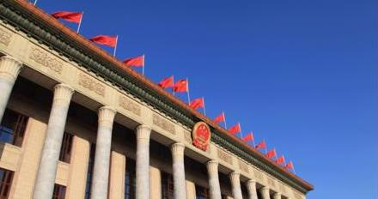
2016: An Important Milestone for China’s Social Development
In 2016, China’s first charity law was passed in March and became effective in September.
China’s Foreign NGO Management Law was passed in last April and took effect in January 2017.
However,
US philanthropy has kept a low profile lately. They feel more difficult to find the right way to carry out the work.
Notes:
Last year, China’s first charity law was passed in March and became effective in September.
China’s Foreign NGO Management Law was passed in April and took effect in January this year.
Both laws indicate the intention of the government to strengthen regulations of the emerging fields of philanthropy.
However, US philanthropy has kept a low profile lately. They feel more difficult to find the right way to carry out the work.
What’s the problem and why such a huge gap?

Slide 13
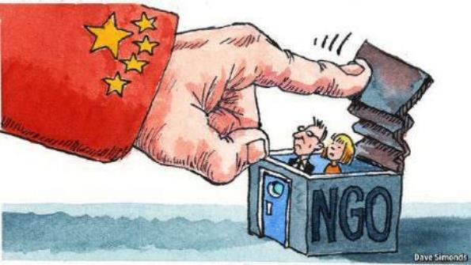
How to deal with the political sensitivity?
Problem
Notes:
Political sensitivity is absolutely the main reason. The new law is taken to against the kind of Western influences and ideas that China’s leaders view as a threat to the current political system. Universities must report all the academic researches supported by US philanthropy to different government sectors for investigation.

Slide 14
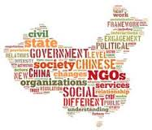
Future – The Rise of University Foundations
US Philanthropy - Mitigate Political Risks
Donate in the U.S.: University Overseas Foundations
Donate in China: University Mainland Foundations (Partners)
University Related Foundations – Management Challenges
Keep the free will of academic researches
Understand the true intentions of overseas donations
Manage donation programs professionally
Notes:
What’s the future?
Public opinion on this law remains divided. Under the new law, foreign groups working in China will have to find an official Chinese sponsor and must register with the police.
In this case, I think university related foundations will become the most important channels for US philanthropy to donate to China’s higher education. They can either give directly through universities’ overseas foundations in US or local foundations in China to mitigate political risks.
It also challenges the management of university related foundations. They need to keep the free will of academic researches, understand the true intentions of overseas donations, and manage donation programs professionally. That’s part of the reasons why I am here, learning at Columbia.

Slide 15
Questions
I think as long as a university is built within a country, it is difficult to be truly independent of politics. Philanthropy has the same issue although it is for public good. Do you agree or disagree with my opinion?
How do you evaluate the trend of international fundraising of Chinese universities?
Notes:
I left two questions at the end:
I think as long as a university is built within a country, it is difficult to be truly independent of politics. Philanthropy has the same issue although it is for public good. Do you agree or disagree my opinion?
How do you evaluate the trend of international fundraising of Chinese universities?

Slide 16
References
The Rockefeller Foundation: https://www.rockefellerfoundation.org/
The Ford Foundation: http://www.fordfoundation.org/
China Foundation Center: http://www.foundationcenter.org.cn/
Francis X, Sutton, “American Philanthropy in Educational and Cultural Exchange with the People's Republic of China,” in Educational Exchanges: Essays on the Sino-American Experience
Edward Wong, “Clampdown in China Restricts 7,000 Foreign Organizations,” in The New York Times, Apr. 28, 2016
Global Impact, “2013 Assessment of U.S. Giving to International Causes,” http://charity.org/sites/default/files/userfiles/pdfs/Assessment%20of%20US%20Giving%20to%20International%20Causes%20FINAL.pdf
Wikipedia: Philanthropy in the United States
Notes:
Here are the references. Thank you.

Slide 17
Thank You

