Slide 1
The Next Big One: Detecting Earthquakes and other Rare Events from Community-based Sensors
Faulkner, Matthew, Michael Olson, Rishi Chandy, Jonathan Krause, K. Mani Chandy, and Andreas Krause from california institute of technology
Presented by tengxiang wang

Slide 2
Can one use cell phones for earthquake early warning?

Slide 3
approach
Learn sensor-specific decision thresholds online, in a distributed way.
Maximize anomaly detection performance
Constrain the false alarm rate
Implemented in Community Seismic Network (CSN)

Slide 4
Community seismic network website

Slide 5
Basic Set up

Slide 6
Problem statement
A set of N sensors make repeated observations Xt = (X1,t, . . . , XN,t)
To detect the occurrence of an event Et ∈ {0, 1}
in the decentralized setting, where each sensor s analyzes its measurements Xs,t, and sends a message Ms,t to the fusion center
Ms,t = 1 means that sensor s at time t estimates that an event happened; Ms,t = 0 no event happened at that time
True positive, true negative, false positive, false negative

Slide 7
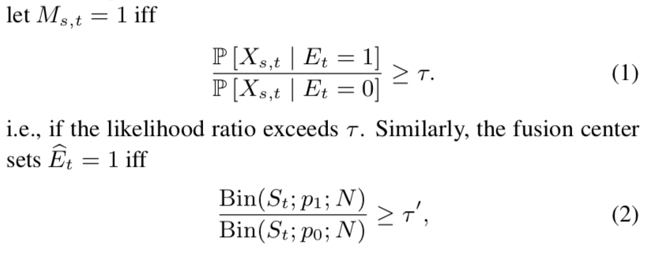
Classical Decentralized Detection
Assumes that we know how likely particular observations Xs,t are, in case of an event occurring or not occurring
optimal strategy is to perform hierarchical hypothesis testing:
where St = Ps Ms,t is the number of picks at time t; pl = P[Ms,t = 1 | Et = l] is the sensor-level true (l = 1) and false (l = 0) positive rate respectively
Bin(·, p, N ) is the probability mass function of the Binomial distribution

Slide 8
Challenges for the Classical Approach
Sensors are highly heterogeneous (i.e., the distributions P[Xs,t |Et]aredifferentforeachsensors)
Since events are rare, we do not have sufficient data to obtain good models for P [Xs,t | Et = 1]
Bandwidth limitations may limit the amount of communica- tion (e.g., number of picks sent).

Slide 9
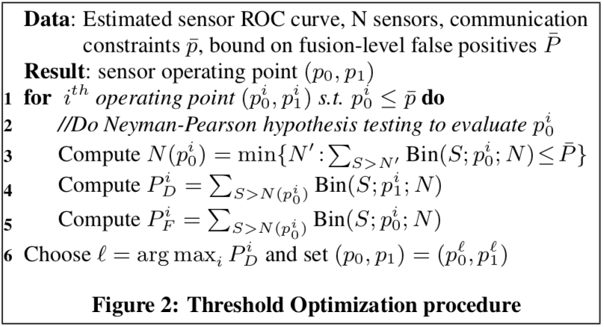
ONLINE DECENTRALIZED ANOMALY DETECTION
Online Density Estimation
OnlineThresholdEstimation
HypothesisTestingforSensorFusion

Slide 10
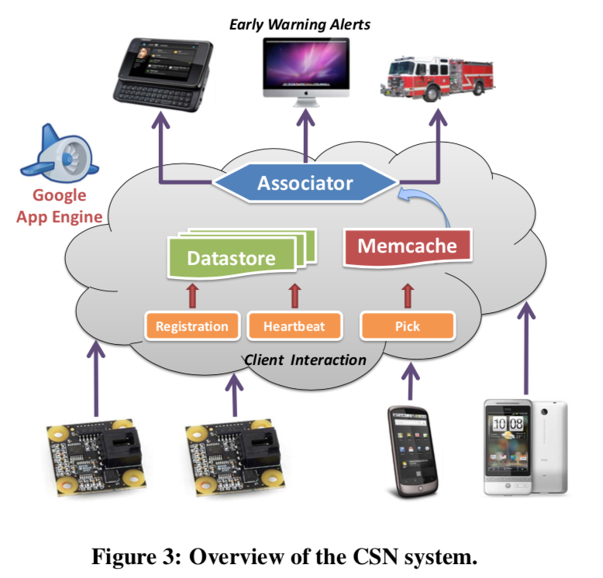
Community seismic network
Community sensors: Android and USB Accelerometers (Phidgets)
When resting, the phones experienced noise with standard deviation ≈ 0.08 m/s2, while the Phidgets, 0.003 m/s2.
Earthquakes with magnitude 4(light) on the Gutenberg- Richter scale achieve an acceleration of approximately 0.12 m/s2
earthquakes of magnitude 5(Moderate) achieve acceleration of 0.5 m/s2, in- creasing to roughly 1.5 m/s2 for magnitude 6 event

Slide 11
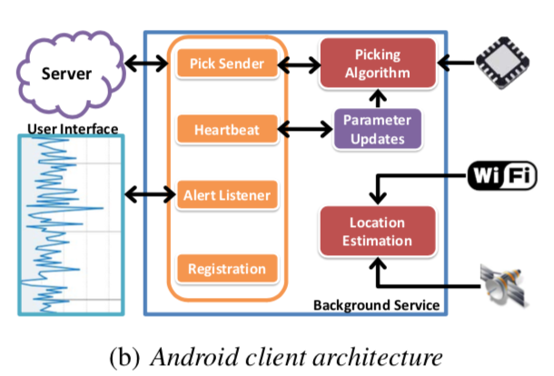
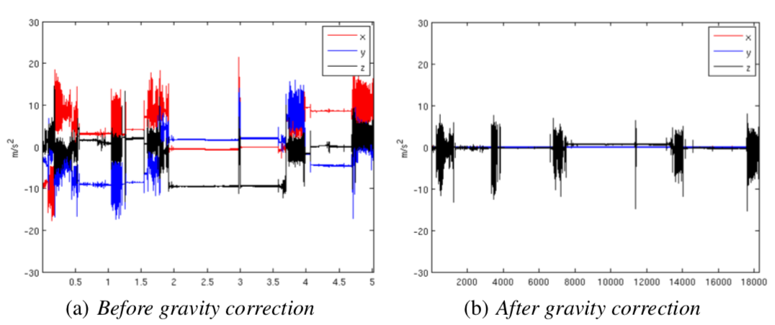
Community seismic network: Android client
5h recording three-axis accelerometer data during normal cell phone use

Slide 12
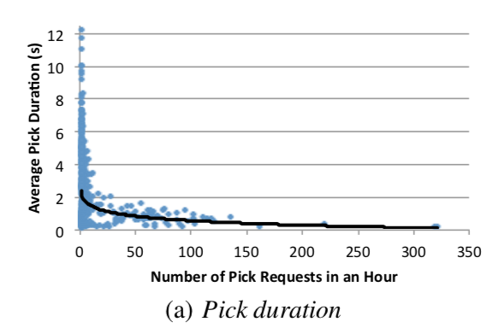
COMMUNITY SEISMIC NETWORK: CLOUD FUSION CENTER
Platform: Google App Engine
Pros: Scalability, Data Security, Ease of Maintenance
Cons: Loading requests

Slide 13
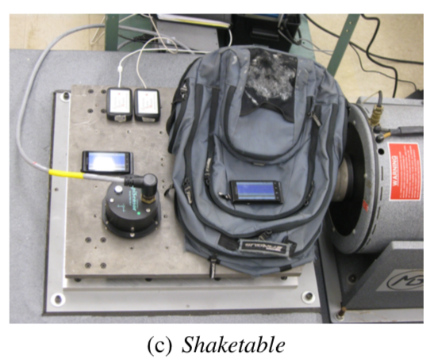
experiments
Data Sets:
Normal: 7users carrying Android phones throughout daily routines, 7GB accelerometer data and 20 USB accelerometers recorded 55GB over 4 months
Anomaly: use simulated observations, extracted 32 records of moderately large(M5-5.5) events.

Slide 14
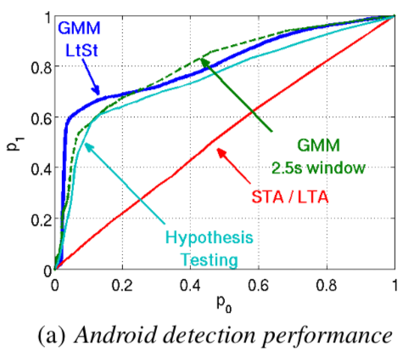
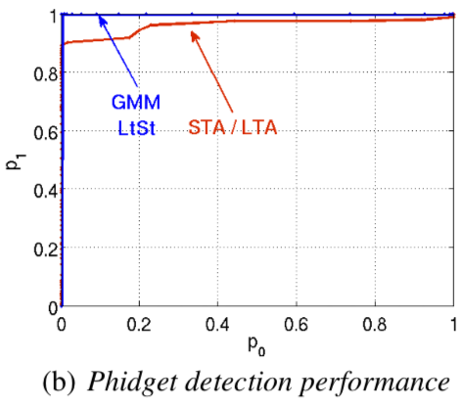
Picking algorithm evaluation
Hypothesis-testing based approach
Domain specific baseline algorithm, STA/LTA
Simplified GMM based approach
Authur’s full GMM approach

Slide 15
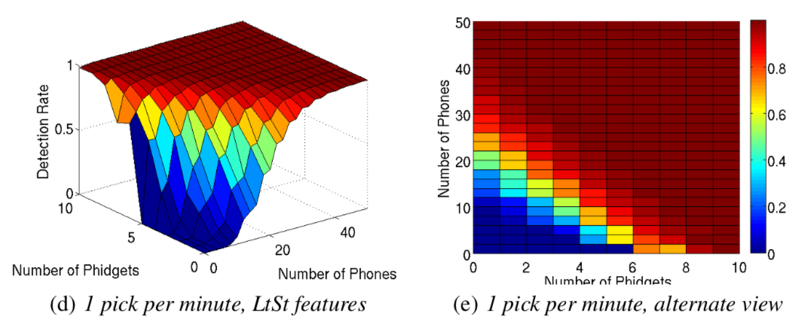
Sensor fusion & sensor type tradeoff
Spatial cell: 20 km × 20 km
60 phones per cell suffice
50 phones or 10 Phidgets enough to detect M5 with close to 100% success

Slide 16
Shaketable validation
Reproduce three records of M6-8 earthquakes
All 6 recordings (3 from phone on the table and 3 from phone in the backpack) successfully detected

Slide 17
https://csn-server.appspot.com/#/map

