Slide 1
AutoCalib: Automatic Traffic Camera Calibration at Scale
microsoft reaserch: Romil Bhardwaj, Ganesan Ramalingam, Ramachandran Ramjee
ohio state univeersity: Gopi Krishna Tummala, Prasun Sinha
Proceedings of the 4th ACM International Conference on Systems for Energy-Efficient Built Environments (BuildSys 2017), Delft, The Netherlands, November 2017.
Presented by tengxiang wang

Slide 2
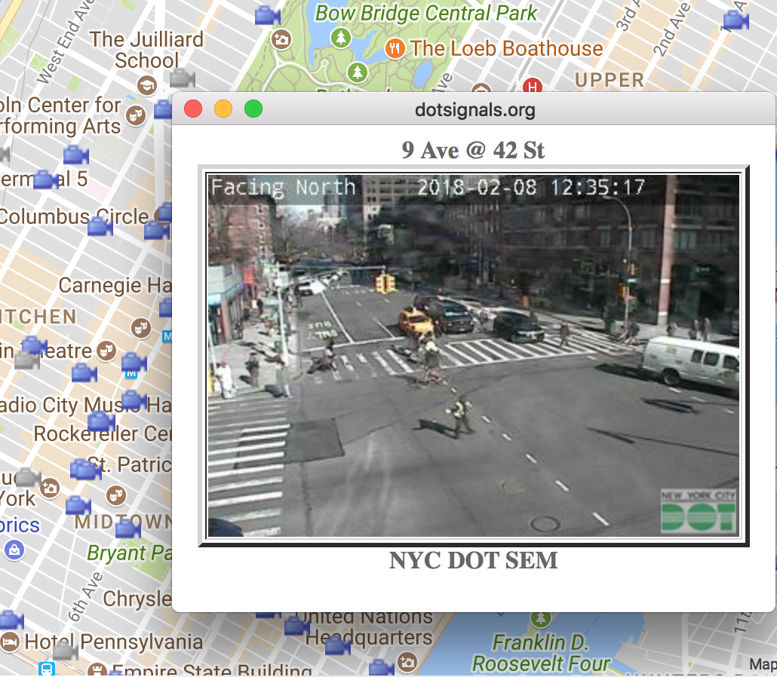
Traffic cameras: what they can do
Identifying speeding vehicles, city road planning, accident prediction and prevention, etc.

Slide 3
Traffic Camera calibration
Camera Parameters:
Intrinsic Parameters:
Focal length
Extrinsic Parameters:
Orientation (rotation matrix R),
Position of the camera in real-world coordinates(T)
Challenges: requires enormous manual effort

Slide 4
Calibration problem
R: rotation matrix
T: translation matrix
Perspective-N-Point problem:
With n ≥ 4 different points, as well as the camera’s intrinsic parameters, we can solve for the camera’s extrinsic parameters using equation 1.
Call solution SolvePnP

Slide 5
Current calibration works

Slide 6
aUTOCALIB System Design
Challenges:
Low-resolution images, error in vehicle detection and classification.
Detecting and annotating key-points: Point of interest: tail lamps, side mirrors, etc.
Consolidating a set of calibrations
Vehicle Detection
Automatic Key-point Annotation
Vehicle Model-based Calibration
Filtering and Averaging Calibrations

Slide 7
aUTOCALIB PIPELINE

Slide 8
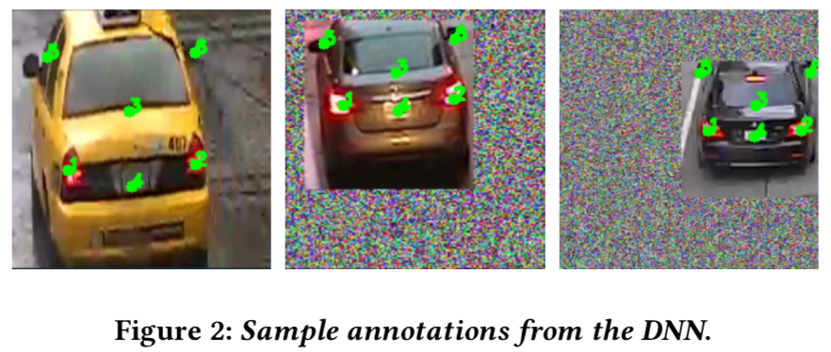
aUTOMATIC KEY-POINT ANNOTATION
CompCars DNN for transfer learning to reduce trainning data and time
Manually annotated 486 images for trainning

Slide 9
Vehicle model-based calibration
Real-world 3D coordinates of the key-points
With SolvePnP to calibrate the camera
10 car models selected.
Low resolution image is a disaster for car classification
Every identified car image producing 10 calibrations!

Slide 10
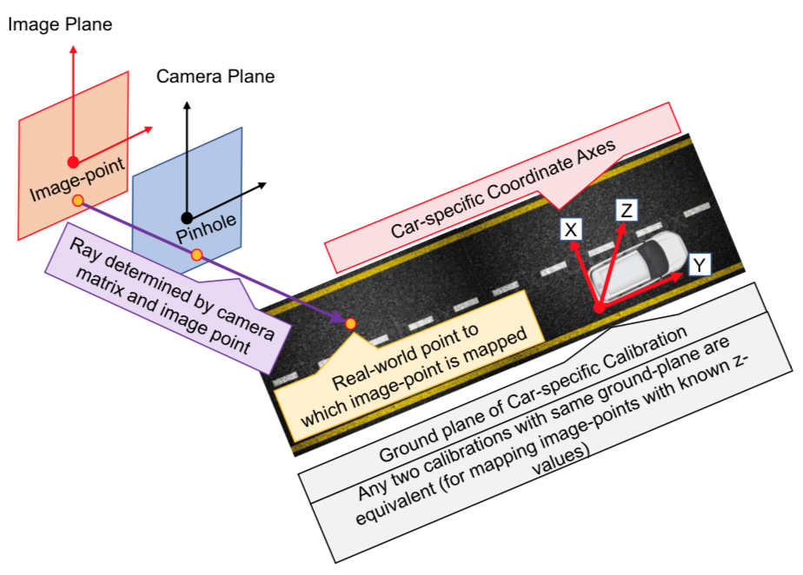
Filtering and averaging calibrations
Large # of calibrations
Annotation errors: DNN-based annotation tool introduces an error of a few pixels
Vehicle identification errors: The car in the image may not belong to any of the 10 models.
Statistical filters

Slide 11
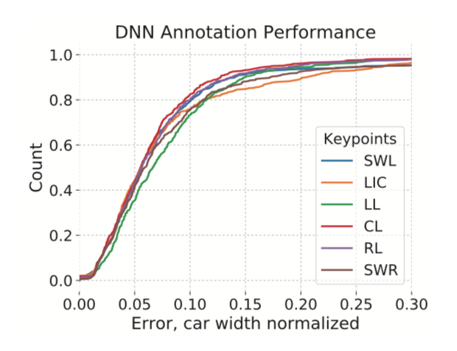
Evaluation
Key-point annotation accuracy

Slide 12
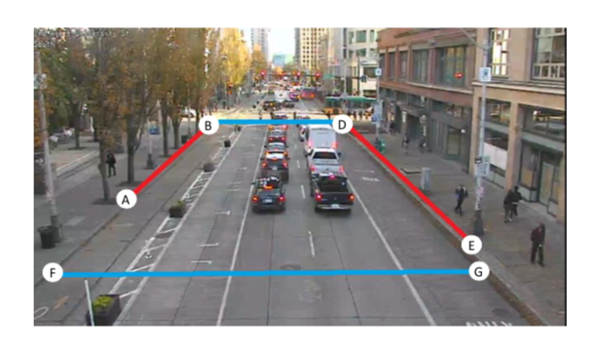
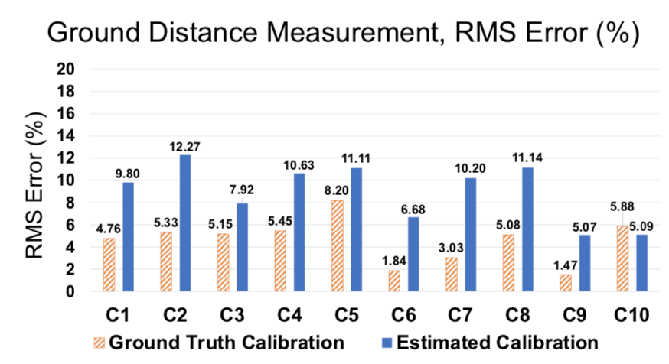
Evaluation
Ground truth for evaluation:
Example of Ground Truth Keypoints (GTKPs) marked in a frame.
The distance measurement errors for the ground truth calibrations, which are indicative of the errors in GTKP annotation, have an average RMS error of 4.62% across all cameras. AutoCalib has an average error of 8.98%.

Slide 13
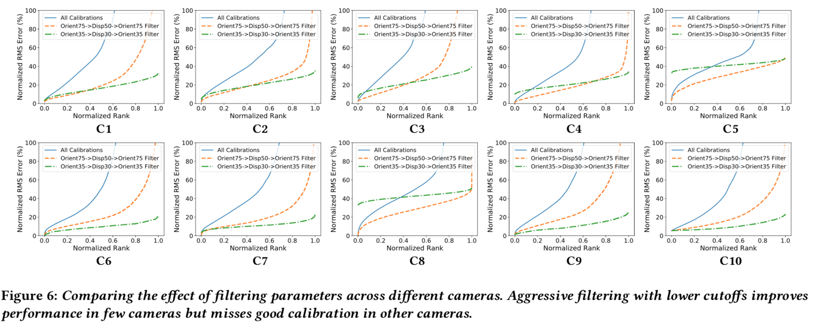
Calibration accuracy

Slide 14
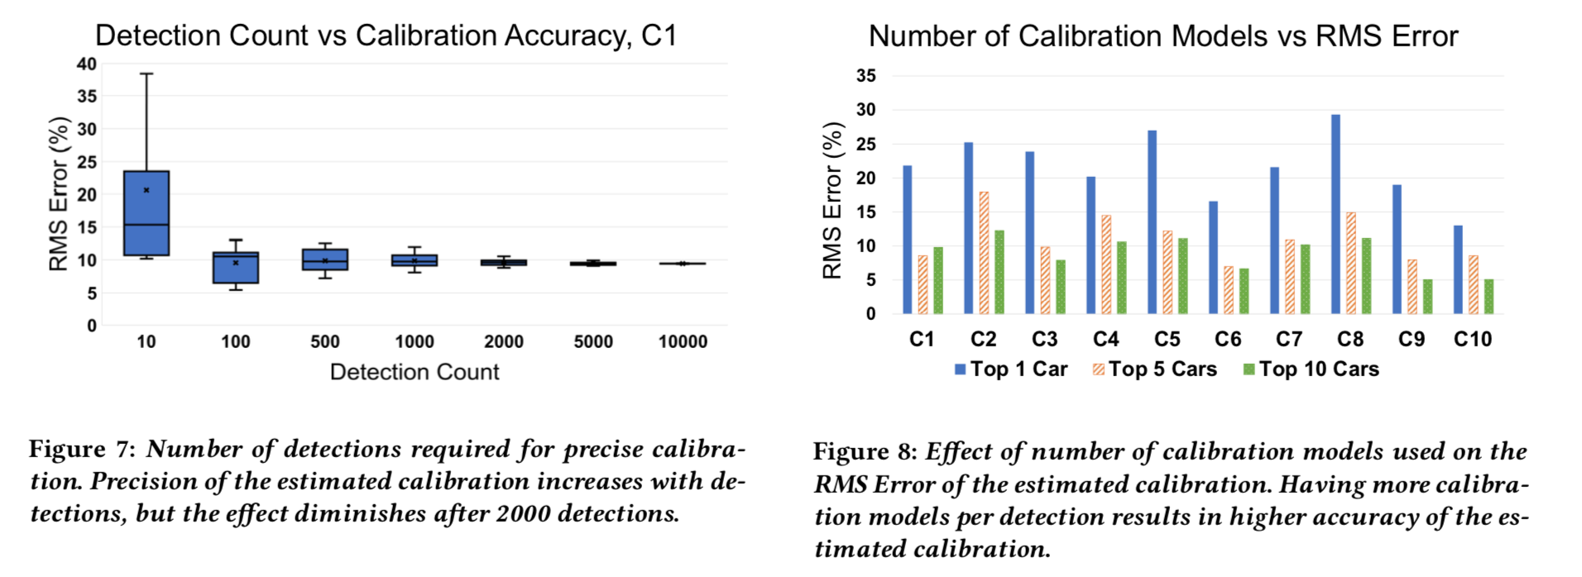
Calibration accuracy

Slide 15
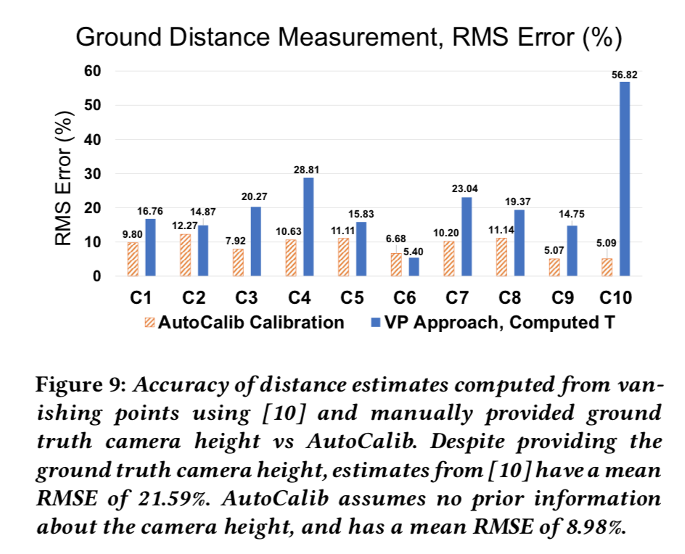
A comparison to related works
Vanishing Point-based approaches

Slide 16
Discussion

